Slide 1

A project on c# based project for super market management system
Presented By |  | Supervised By
S M Masfequier Rahman Swapno(18192103087) |  | Meer Muttakin Alam Teaching Assistant
Sazzad Rahman Nahid (18192103051) |  | Dept. Of CSE (BUBT)
Al Ahad Sufian (18192103056)

Slide 2
Outline of this presentation
Introduction(Introduction,Project Description,Problem statement, Objective)
Related works(Some work as our project, Problems with the existing system)
Proposed architecture(Admin menu list,Seller menu list,ER Diagram)
System requirements
Implementation

Slide 3
Outline of this presentation
6. Result and Evaluation
7.Conclution
8.Future Work

Slide 4

1. INTRODUCTION

Slide 5
introduction
A supermarket is a self-service shop offering a wide variety of food, beverages and household products.
It is larger and has a wider selection than earlier grocery stores.
Seller can deal with customers easily and correctly.
Include both purchase and sale of products.
It is smaller and more limited in the range of merchandise than a hypermarket or big-box market.

Slide 6
Project Description
Based on the transactions in a Super Market.
Any modification to be done in the item name or item rate cane be done only by Admin.
Right to delete any item details reset with the Admin too.
As the customer buys the products and comes to the billing counter, the user is supposed to enter the item name purchased.
The system will display all the items a customer wants to purchase

Slide 7
Problem statement
1.A Good Handle system
2.A Good Data Recording system
3. A Good data updating
4. A Good security system
5.Less Human error
6.Easy Billing system
7.Easy Product Buy-sell System

Slide 8
Objective
To produce software which manage the activities done in a Super-Market
To maintain the records of the sales done for a particular month.
To reduce time in calculation of Sales activities.
To store large amount of data in the database which will reduce clumsiness.
To reduce paper work.

Slide 9

2. Related works

Slide 10
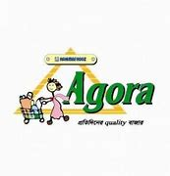


Some work as our project

Slide 11
Problems with the existing system
Manual system faces a lot of inefficiencies.
Hinders smooth flow of work.
Lack of security of data.
Consumes large volume of paper work.
Poor communication may lead to serious inadvertent errors.

Slide 12

3. Proposed architecture

Slide 13
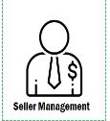
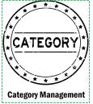
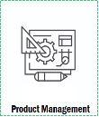

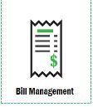
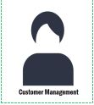
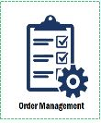
Admin menu list

Slide 14
Seller menu list

Slide 15
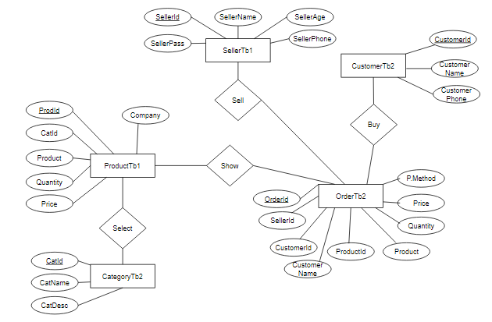
ER Diagram

Slide 16

4.System requirements

Slide 17
Hardware and software requirements
Processor | : Intel dual core or above
Processor speed | : 2.0 GHZ or above
RAM | : 1GB or above
Hard disk | : 20 GB or above
Programming language | : 1. Visual Studio 2. My SQL Server

Slide 18

5. Implementation

Slide 19
Framework Of our system
Super Market Management System
Login
Admin
Seller
Category Management
Seller Management
Product Management
Sells Management
Customer Management
Order Management
Bill Management
Product Management
Customer Management
Order Management
Bill Management
Name
Id
Detiles
Id
Name
Age
Phone
Id
Name
Quantity
Price
Catagory
Category
Seller
Customer
Product
(List)
C.Id
C.Name
C.phone
Order –Id
Customer-Id
Price
Quantity
Seller-Id
Procuct-Id
Payment
Method
Search
Refresh
Name
Quantity
Price
Catagory
C.Id
C.Name
C.phone
Order –Id
Customer-Id
Price
Quantity
Seller-Id
Procuct-Id
Payment
Method
Search
Refresh

Slide 20

6.Interfece

Slide 21
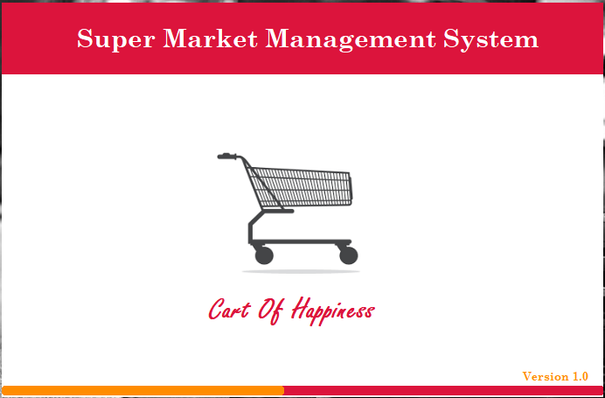
8. Interface
Loading Page

Slide 22
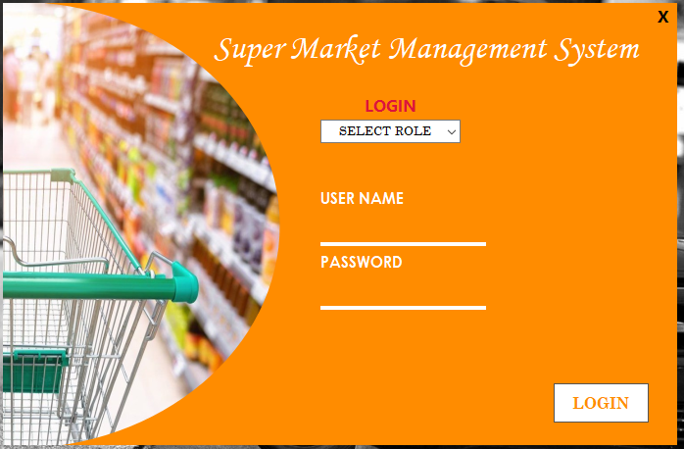
Login Page

Slide 23
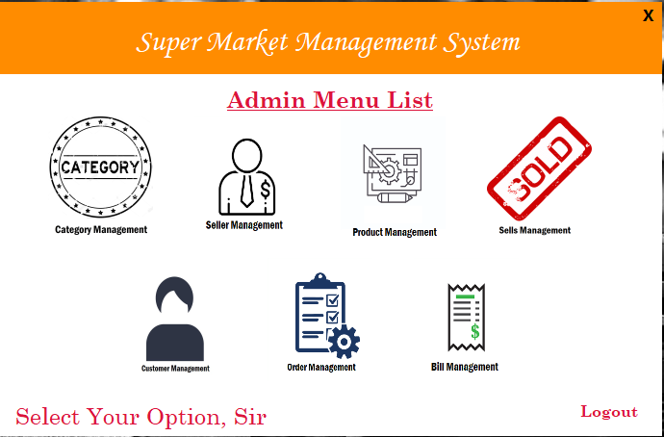
Admin Menu List

Slide 24
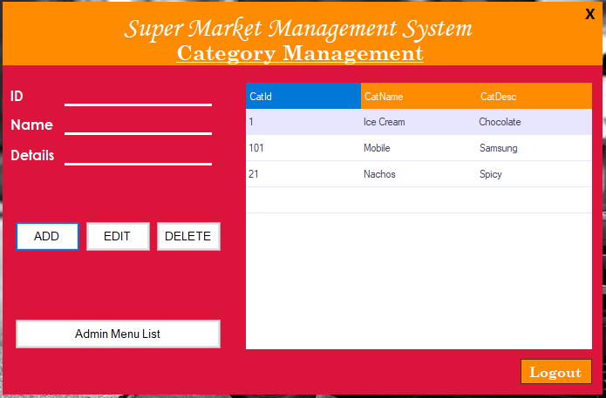
Admin Category Management

Slide 25
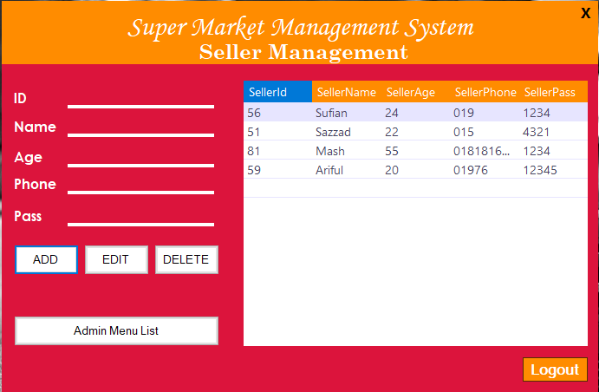
Admin Sellers Management

Slide 26
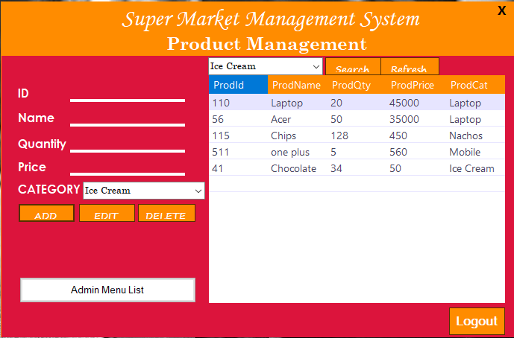
Admin Product Management

Slide 27
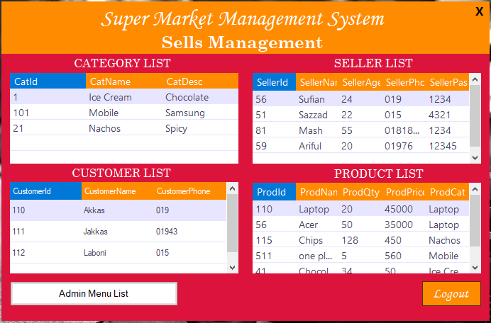
Admin Sells Management

Slide 28
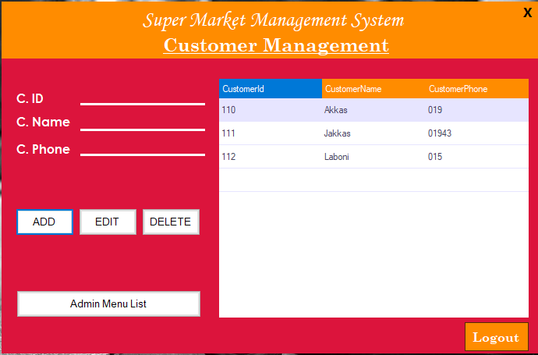
Admin Customer Management

Slide 29
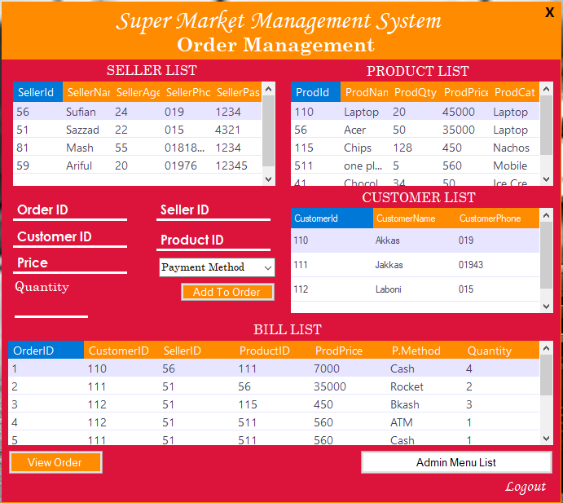
Admin Order Management

Slide 30
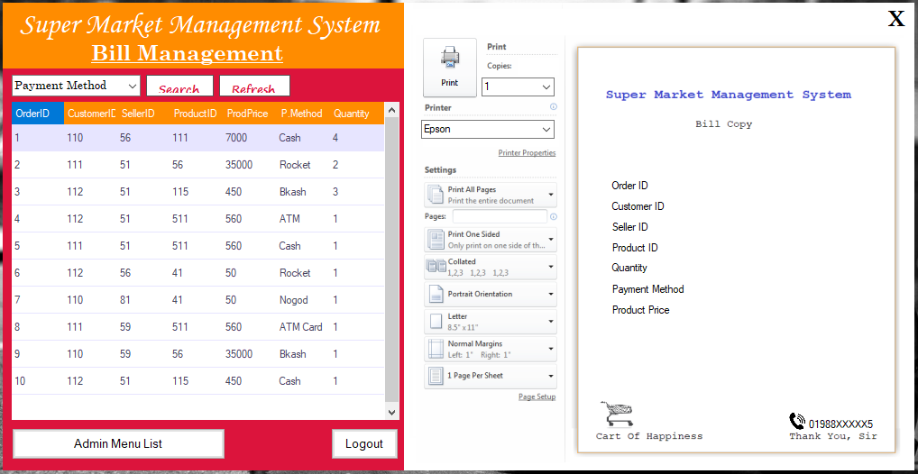
Admin Bill Management

Slide 31
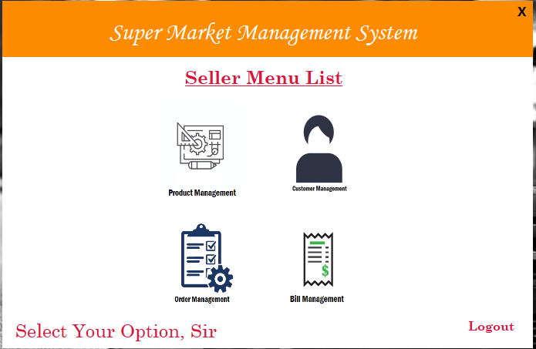
Seller Menu List

Slide 32
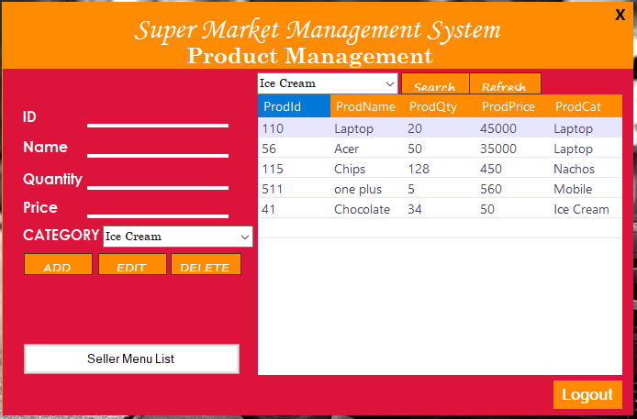
Seller Product Management

Slide 33
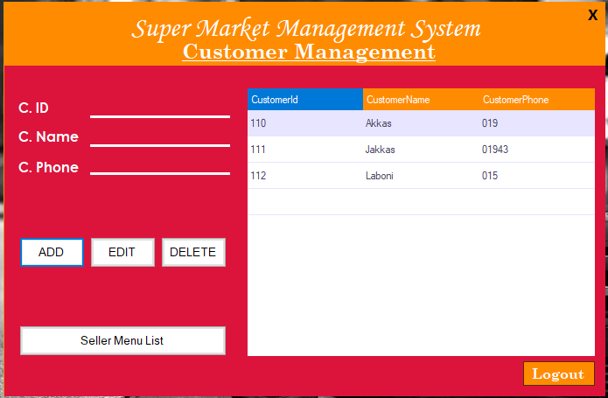
Seller Customer Management

Slide 34
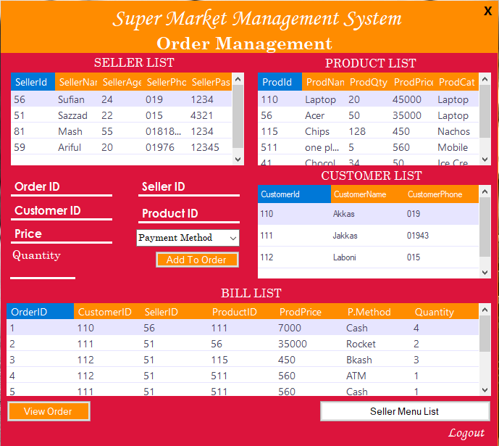
Seller Order Management

Slide 35
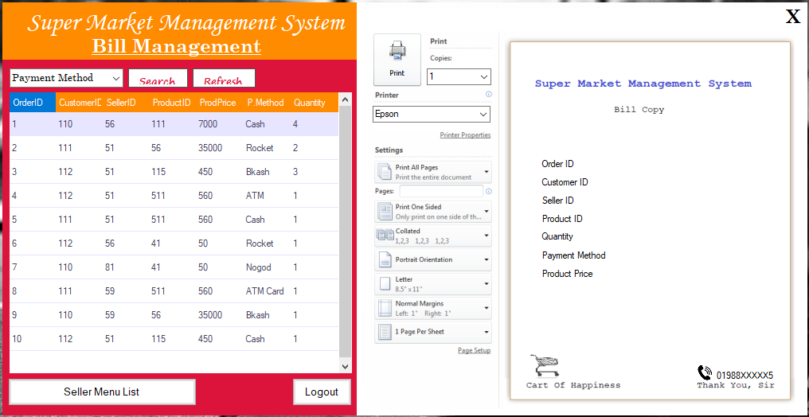
Seller Bill Management

Slide 36

7. Conclusion

Slide 37
9. Conclusion
With business opportunities increasing as never before, companies are in dire need of efficient management. One such key area is to maintain a methodical way of managing large databases, especially in the Retail sector.
DBMS is a vital tool for future growth of business organizations.
It offers a simple, efficient and reliable way of storing, managing and accessing data.
The features offered by DBMS are : Query ability, Backup, Security and Computation which are the needs of a fast-paced corporate system.
To churn profits, companies need to have a good plan along with affective DBMS.
Also Try to implement in online system or want to add in online server.

Slide 38

8.Future work

Slide 39
Will do
1. An advanced password system that will be embedded into all login pages to increase the security of the system.
2. A good internet backup should be automated after everyday sales.
3. Internet Transactions should be allowed.

Slide 40


Slide 41


